Slide 1
Section 13.4
Mathematical Induction
Copyright © 2012 Pearson Education, Inc. Publishing as Prentice Hall.

Slide 2
Copyright © 2012 Pearson Education, Inc. Publishing as Prentice Hall.

Slide 3

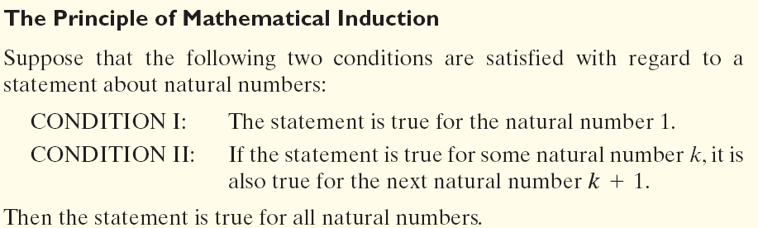

Copyright © 2012 Pearson Education, Inc. Publishing as Prentice Hall.

Slide 4







Assume:
above
Copyright © 2012 Pearson Education, Inc. Publishing as Prentice Hall.

Slide 5



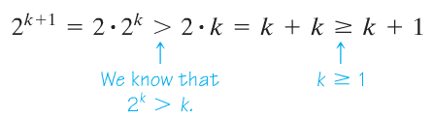
Assume:
Copyright © 2012 Pearson Education, Inc. Publishing as Prentice Hall.

Slide 6
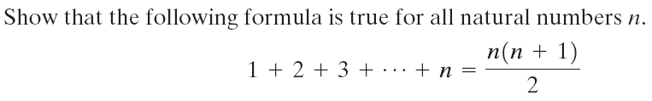


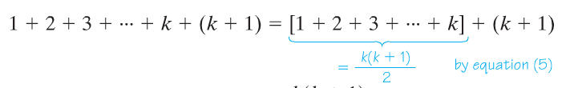



Copyright © 2012 Pearson Education, Inc. Publishing as Prentice Hall.

Slide 7



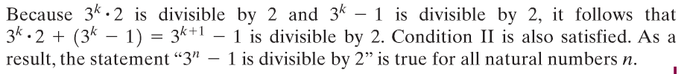
Copyright © 2012 Pearson Education, Inc. Publishing as Prentice Hall.

